Slide 1
An analysis of the accessibility, dissemination, and alignment of ETDs to postgraduate scholarly research in South African universities ETD2022, 7-9 Sept 2022, Serbia

Slide 2
Background
In 2003, Directors of South African University Libraries met for a first national workshop on Electronic Theses and Dissertations at Wits University
There was no donor funding but NRF grant to the PI (Suleman et al)
National Research Foundation committed its support for a national harverster
Committee of Higher Education Libraries South Africa
(CHELSA) committed its support

Slide 3
ETD Repositories in SA HEIs

Slide 4
Software Platform

Slide 5
NRF Feasibility Study (2005/6)

Slide 6
Context post the ETD 2011
Open Access Movement
Committee of Higher Education Libraries South Africa
Institutional Repository CoP, IR-TALK
COAR membership
NRF database of theses and dissertations advocacy & support/hosting for institutions that do not have capacity/competencies
Many SA Universities were starting ETD projects
NDLTD

Slide 7
South African National ETD Project
Managed by South African National Research Foundation
Steering Committee:
CHELSA representatives (University Library Directors)
SA-NRF representatives (Information Management)
Expert, Prof Suleman Hussein, University of Cape Town
3 Sub-projects:
Training and consultation
Capacity building
Hosted repositories
National portal

Slide 8
Training and Consultation
Training Workshops
A: Train the trainers
B: Regular regional workshops
How to set up a repository system
How to manage a repository
Etc.
Consultative workshops
Once a year
All universities represented
Feedback, status updates and buy-in

Slide 9
CHELSA: Repositories development
Smaller universities had no funding, staff or training.
Project started with 23 university libraries
NRF offered to bridge this gap (for 3 years):
Institutions in need could apply for assistance.
DSpace-based repositories were installed and configured, and hosted
remotely at NRF’s premises in Pretoria.
Specialists were sent to the institutions to train staff/capacity building.
Eventually, repositories were migrated –UL, UFH (traditional rural universities which institutions?

Slide 11
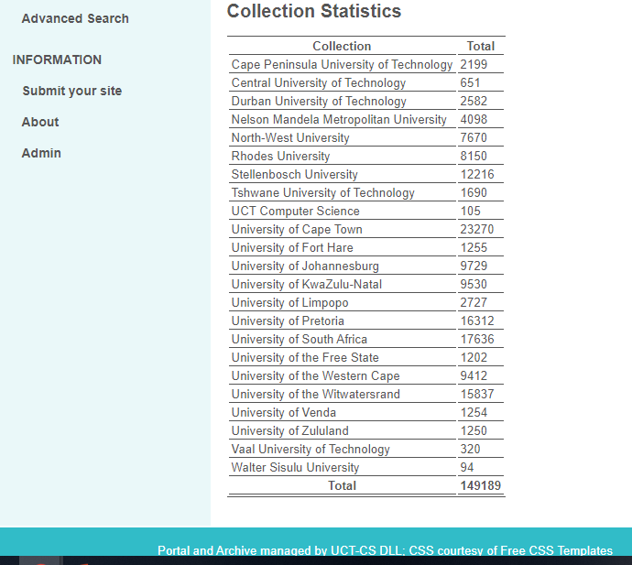

Slide 12
How the Portal works
Metadata
Collected once per day from institutions
Strictly using OAI Protocol for Metadata Harvesting
Collect DC, and ETD-MS metadata if available
Indexed for search/browse
Once per day
DC and ETD-MS are both indexed
Links back to source repositories
Metadata then shared with NDLTD
Via OAI-PMH

Slide 13
Portal Services
Search
+Advanced Search
Browse
OAI Data Provider
RSS Feed
List of contributions
Admin interface

Slide 14
Current Status of the SA-NETD Portal
All 26 SA institutions are committed to Open Access and ETDs.
Now core business of HEIs libraries
Most large institutions have policies on ETDs (and Open Access).
Still some problems when systems are migrated/updated
Skills shortages are forever a problem/limited pool of competent staff
Many institutions are importing skills or buying commercial solutions
Everyone does ETDs - the portal is not able synchronize with some upgraded repositories/software issues
NRF support was withdrawn in 2018 (National NETD Platform)
Portal is now not prioritized by CHELSA with the plan to have a new national portal hosted collaboratively

Slide 15
CHELSA - National Imperative for ETDs
CHELSA should aim to provide:
A national aggregated record of all doctoral theses is critical to access, discoverability and registration of new postgraduate research projects at all South African university institutions
Free access to the full text of as many theses and dissertations as possible for use by all researchers to further their own research
Universities should ensure that their repository content is exposed to a variety of services including search engines and the National repository aggregators/harvesters
Digitisation priorities for print theses at CHELSA members
Availability of ETDs in the NETD portal

Slide 16
USAf/DHET – Sustainability of NETD
HEIs repositories should be a the foundation for a distributed, globally networked infrastructure for scholarly communication
USAf should support the NETD portal, pay for its services and infrastructure
Value added services can be deployed, thereby transforming the system, making it more research-centric, open to and supportive of innovation, while also collectively managed by the scholarly community
National repository with interoperability, with uniform behaviours across HEIs repositories is needed by integrating with existing global scholarly infrastructures, i.e. NDLTD
Help transform the scholarly communication of ETDs through, open content, real-time dissemination, and collective innovation

Slide 17
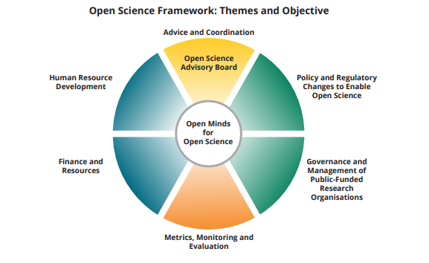
Impact of the new South African Open Science Policy in public comment
The six themes of the proposed Open Science Framework
https://esastap.org.za/wp-content/uploads/2021/06/SA-EU-OPEN-SCIENCE-FRAMEWORK.pdf

Slide 18
Repurposing the NETD repository services
Technical architecture and infrastructure, with respect to interoperability requirements
Review of the ETD repository and other repository service Data repositories and OJS platforms
Building viable and sustainable repository services at national level
Repository framework for HEIs with attention to scalability, viability and sustainability
Seamless, searchable, discoverable and aggregated HEIs repository network
Nationally funded ETD platform, networked to all HEIs libraries to support registration of M&D research projects and dissemination of ETDs

Slide 19
Role players
Repository managers: those who manage institutional repositories
Governance and management of public-funded research HEIs: Universities, USAf, DHET
End users as searchers/readers: students, researchers, supervisors, and interested public
Content aggregators: SABINET, NDLTD, Proquest, BASE, Altmetrics, etc.
Meta-users: Institutional and national data analysists
Entrepreneurs: commercial users who see a way to produce value-add from ETDs, i.e. funders, business, innovators, etc.
IPR & Copyright: research-based institutions’ technology-transfer offices, NIPMO, etc.

Slide 20
Usage and impact
Capture elements of societal impact
Demonstrate new knowledge and show significance of M&D research
Offer speed and discoverability
Open access advantage
Sense of ownership by content creators – ORCID and Google Scholar, etc.
Usage statistics and feedback services
Meta-analysis services: Altmetrics, Webometrics, and Citations

Slide 21
Challenges to be overcome
CHELSA to take strong leadership role in securing funding and advocacy.
Eliminate technological and human capacities in the HEI libraries
Good communication channels between repository managers
Formal communication between CHELSA, USAf, DHET
Shared software and hardware requirements
Lack of a HEIs repository framework – technical model
Repository and end-user service overview
Metadata standards and content
Interfaces – Open Archives Initiative Protocol for Metadata Harvesting
- (OAI-PMH)
Technical architecture

Slide 22
Harvesting using OAI-PMH
Internet
Others, NDLTD,
CHELSA’s NETD Harvester
OAI-PMH
Exposed metadata
South African HEIs Repository

Slide 23
Conclusion - what does the SA NETD case study tell us!
Out of 26 CHELSA members only 24 have repositories
How do we organize for a National Portal to better support the knowledge generated through Public funding in contribution to the knowledge economy for sustainable development?
How do we demonstrate the self reliance of CHELSA through re-establishment of a National Portal not reliant on a funding agency?
How do we sell National Portal in the realisation of the National Open Access Policy?
How do we capture & communicate the value of localised COP that harnessed the practices within diverse academic libraries repositories?;
How do the re-established National Portal forms part of a substantial and growing community of open infrastructures that are committed to fair and inclusive open access, open data and open science?

Slide 24
References
COAR 2021 article - COVID-19 has profoundly changed the way we conduct and share research. Let’s not return to business as usual when the pandemic is over!
Prof Hussein Suleman, Head of Department and Professor in Computer Science in the School of IT at the University of Cape Town – slides.

Slide 25
Presenters
Lazarus G. Matizirofa - Deputy Director and Head of Scholarly Communications, Digital Systems and Services at the University of Pretoria Libraries, South Africa
https/orcid.org/0000-0002-0021-2738
Daisy Selematsela (PhD) - University Librarian of Witwatersrand University, South Africa
https://orcid.org/0000-0002-9035-1319

