Slide 1
The world of research data: when should data be closed, shared or open
Dr Heila Pienaar Deputy Director: Strategic Innovation UP Library Services

Slide 2
Content
Physical characteristics of research data before it can be shared
Modes of data sharing
Case study: public humiliation in the name of Open Science
Advantages and disadvantages of sharing research data
AI to the rescue of open research articles?
In conclusion

Slide 3
Characteristics of research data before it can be shared
Not all research data are digitally born
Research data must be digital in order to be able to preserve & share it (this is often not the case)
Research data must be uploaded to a digital system / database / repository to make general sharing possible
Research data must be packaged in a format for ease of download and use (meta-data; provenance)
Analysis software programmes should be provided with the research data (with instructions)

Slide 4
https://www.youtube.com/watch?v=N2zK3sAtr-4

Slide 5
Modes of data sharing
Once data is collected and analysed, it can be released in a variety of ways:
closed networks within an organisation or project
to researchers working on the same topic (‘invisible colleges’)
to platform-dependent sharing between peer organisations
to publishing with closed licenses
to publishing openly but with permission
to publishing with fully open licenses

Slide 6
Case study: public humiliation in the name of Open Science
How freely should scientists share their data – a case study by Daniel Barron on August 13, 2018 https://www.natureindex.com/news-blog/how-freely-should-scientists-share-their-data
Jack Gallant is a cognitive neuroscientist at the University of California, Berkeley
In 2011 he showed that he could—based only on measures of brain activity—actually reconstruct images of movies people were watching
In 2016 he showed what listening to the Moth podcast does to our brains. His analysis of the Moth podcast was published in Nature (Moth podcast – true stories told live)

Slide 7
http://gallantlab.org/index.php/publications/nishimoto-et-al-20 11/

Slide 8
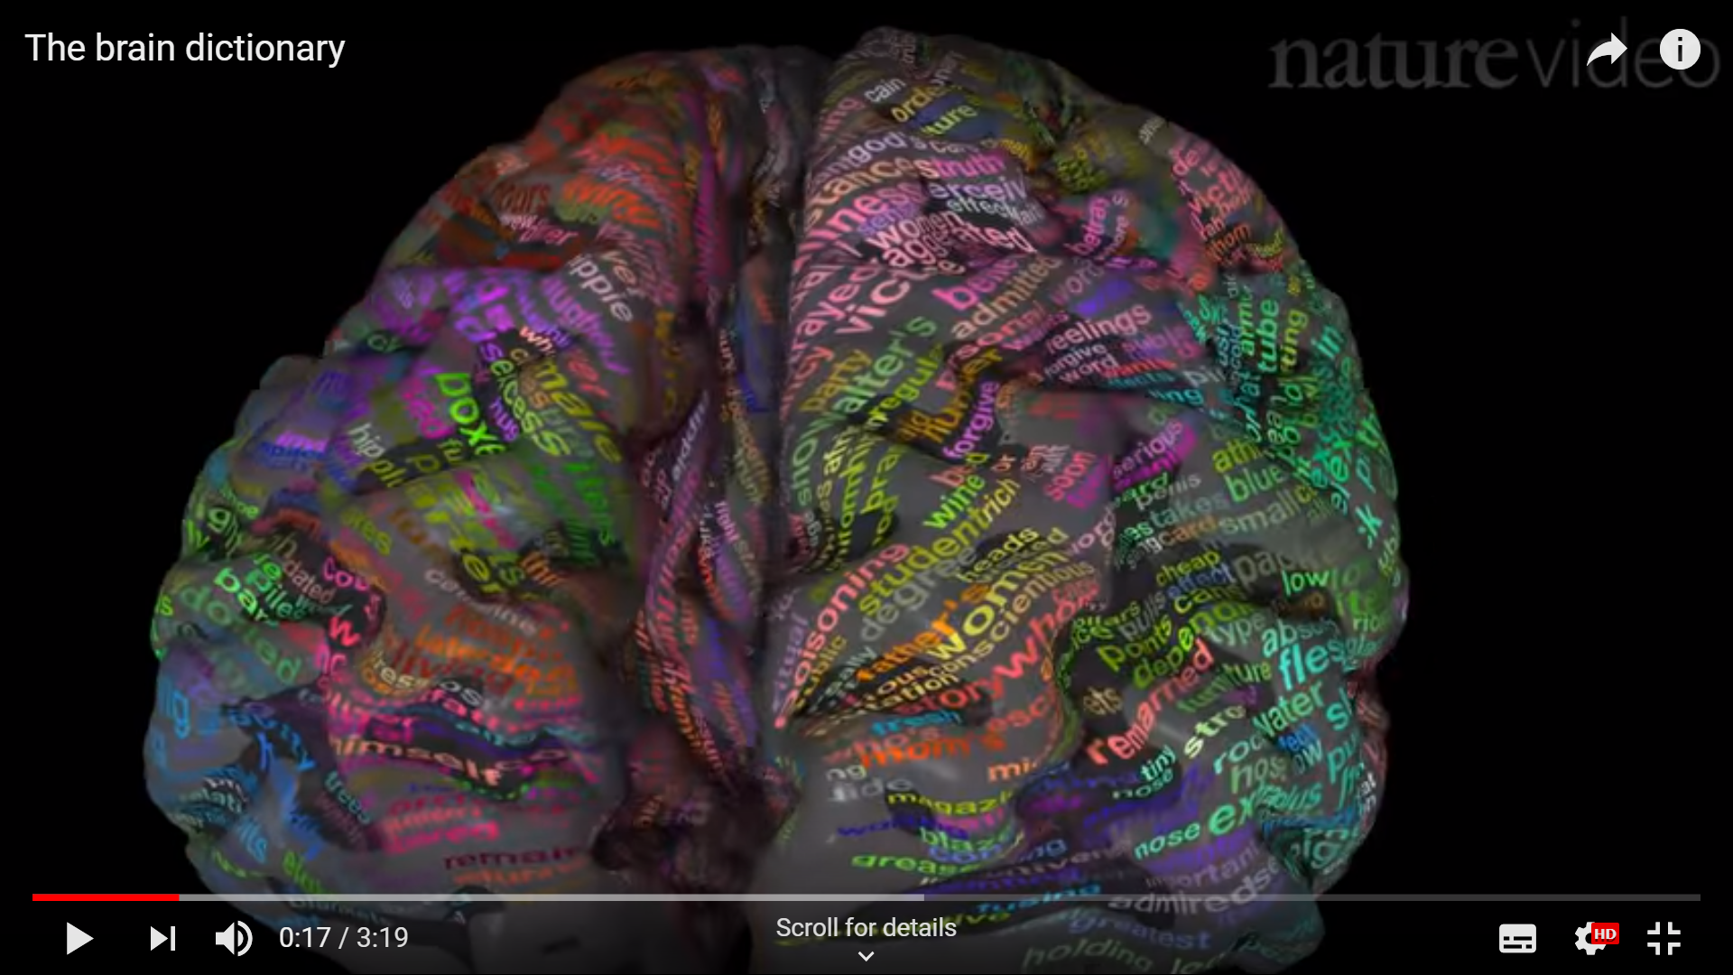
Natural speech reveals the semantic maps that tile human cerebral cortex
https://www.youtube.com/watch?v=k61nJkx5aDQ&feature=youtu.be

Slide 9
Publicly humiliated on Twitter
Manilo De Domenico a theoretical physicist, tweeted, “We keep trying to ask access to data used in your nature 2016, but we received not a single reply, yet.”
Gallant replied. “The original authors are still writing further primary research papers on these data so they haven't been released yet but we expect to be able to do that very soon.”
“‘We still want exclusivity to publish more papers’ isn’t a great excuse. Did you note data restrictions in the manuscript?” tweeted Andre Brown, referring to Nature’s policy that, on publication, authors should make their data, code and protocols “promptly” and publicly available

Slide 10
Domenico lamented that Gallant’s paper had given him a series of ideas that he wanted to test but couldn’t because he needed Gallant’s data, “This is not advancing human knowledge,” de Domenico asserted.
Gallant dug in: “And why do you assume that your project is better than the ones that we are continuing with these data? My students and postdocs are an awesome group of people, the stuff they have in the pipeline is great! But I can’t afford for them to be scooped.”

Slide 11
Barron (blog writer) questions the ideals of Open Science
A highly-productive lab writes a grant to fund a series of studies and the development of new tools. They spend years collecting data and building the tools for these proposed studies
Then, they finish a portion of the project and begin to publish results. Should they be required to release their data to the community? If so, when? Who owns that data? And what business do journals have in enforcing data sharing?
Barron is questioning the role of publishers and journals in the open data debate – is it their role to force the sharing of research data? Barron remains unconvinced that there is an immediacy to sharing most forms of scientific data—especially an immediacy in the name of the public interest
I am convinced that other scientists feel an immediate need to analyse data sets that they do not own—especially if the results of a particularly excellent data set can be published in Nature and make them famous

Slide 12
I also heard cautionary tales that the Open Science movement had a dark side, that “openness” had, at times, devolved into bullying and theft. Some compared the Open Science movement to Communism: good in principle, impossible in practice. In informal settings — at dinner, over drinks — I was reminded that science was a competitive business

Slide 13
Advantages & disadvantages of sharing research data
It seems that there are two types of research results that should be shared as soon as it is possible, i.e. clinical trial data and rare-diseases research.
A framework for responsible sharing of clinical trial data has been developed in order to maximize benefits to participants in clinical trials and to society, while minimizing harm. https://www.ncbi.nlm.nih.gov/books/NBK253390/
Rare-disease families’ access to medical research is very problematic. If these families can’t afford subscription fees they have to navigate a variety of gatekeeping mechanisms in order to access research that could help them make critical health decisions. “Yes, everyone should have rainbows, unicorns, & puppies delivered to their doorstep by volunteers. Y’all keep wishing for that, I’ll keep working on producing the best knowledge and distributing it as best we can.” Quote by an Elsevier official – later retracted …. https://slate.com/technology/2018/08/who-gets-to-read-the-research-taxpayers-fund.html

Slide 14
Advantages
To maximize the impact of data (or conclusions drawn from it). Scientists base their research on foundations laid by other scientists, e.g. scientific theories proven by other scientists and research data collected by other scientists.
Sharing data reduces both the cost of data collection and the overall cost of research
The use of common data bases allows scientists to test and retest their findings against those of other scientists and promotes progress in science http://sites.nationalacademies.org/cs/groups/pgasite/documents/webpage/pga_053478.pdf
Inform collaboration
Provide stronger evidence for advocacy
Increase efficiency of service delivery among a wider audience than just within your project
Play role in decision making within other projects
Publishing your data can also allow people who might not have otherwise been well-informed enough about your project, to have a say - for example, those who are reflected in the data

Slide 15
Disadvantages
Once data is published, it’s impossible to anticipate how it might be shared further, and once it’s out in the open, there’s no telling how it will be adopted, re-purposed and re-used for any number of purposes
Ethical and practical implications, e.g. a group of people could be identified in spite of anonymising personal information
Participants seeing that their data is used in a way they don’t agree with, or that puts them in danger
Researchers should carefully consider the implications of sharing, whether to share at all, and the licensing conditions or terms and tools that you can use to reduce the risk of harm, while still permitting beneficial outcomes https://responsibledata.io/resources/handbook/chapters/chapter-02c-sharing-data.html

Slide 16
AI to the rescue of open research articles, and perhaps open research data at a later stage?
Researchers who are busy with specialised research sometimes query the open access movement as they are of the opinion that few people will understand their work
Impactstory to the rescue - Get The Research: Impactstory announces a new Science-Finding tool for the general public (https://gettheresearch.org)
It is aimed at serving the general public rather than an audience of scholars and specialists, and it promises to provide a new level of accessibility to published scholarship.
It will be built on the 20 million open access articles in the Unpaywall (http://unpaywall.org) index, and feature AI-powered tools that help make the content and context of scholarly articles more clear to readers. https://scholarlykitchen.sspnet.org/2018/11/12/get-the-research-impactstory-announces-a-new-science-finding-tool-for-the-general-public/

Slide 17
In conclusion
Sharing of data is highly dependent on the type of research, the type of data and most importantly, the requirements of the funder for that specific research. Open data / Open Science should not be cast in stone, but should be implemented with great care in order not to damage the scientific enterprise

