Slide 1
DSpace System Administration
hilton.gibson@gmail.com

Slide 2
What is the difference between a System Administrator and a Web Programmer?
Basically a system administrator looks after the hardware while a web programmer looks after the software.
Due to the rapid expansion and adoption of high technology it is no longer feasible to employ a “full stack” IT guy.
That is why the separation between hardware and software support. This is also commonly known as “devops” in the IT cloud world.

Slide 3
What is the difference between a System Administrator and a Web Programmer? (cont)
Let me try to explain by way of an analogy using something we are very familiar with, namely property development. Property developers buy land prepared with roads and utilities by the local municipality and erect buildings for occupation by future businesses or residents.
In the same way the technical team, prepares "roads and utilities" by constructing a "data center" which houses networking and server equipment.
Then the technical team "erects buildings" by installing software on the servers. The software on the servers is utilised by the operational team, the equivalent of "businesses or residents" to complete a specific function.

Slide 4
What is System Administration?
According to Wikipedia;
“A system administrator, or sysadmin, is a person who is responsible for the upkeep, configuration, and reliable operation of computer systems; especially multi-user computers, such as servers.”
https://en.wikipedia.org/wiki/System_administrator http://wiki.lib.sun.ac.za/index.php/SUNScholar/System_Admin https://wiki.duraspace.org/display/DSPACE/SystemAdministrators https://wiki.duraspace.org/display/DSDOC5x/System+Administration
Please note: A System Administrator is NOT a programmer!!!

Slide 5
What core skills should a System Administrator have?
Core Skills
Expert with the Ubuntu Linux server operating system Expert with the Tomcat java webapp server framework Expert with the LAMP stack webapp server framework Expert with virtualization and cloud services Professional BASH programming skills Professional TCP/IP networking skills Familiarity with a major vendors server hardware Familiarity with a major vendors networking hardware

Slide 6
What expert skills should a System Administrator have?
Specialist Skills
Expert DSpace infrastructure support skills. Expert EPrints infrastructure support skills. Expert PKP infrastructure support skills. Expert Open Data infrastructure support skills. Expert Open Educational Resources infrastructure support skills.

Slide 7
How do you find a System Administrator?
Technology Universities
The ideal candidates are graduates from one of the technology universities in South Africa who have studied information technology or computer science or electronics and have specialised in open source software systems support. Below is a list of technology universities with the relevant departments.
http://www.cput.ac.za/academic/faculties/informaticsdesign/prospectus http://www.cut.ac.za/faculty_pages/ndip-information-technology http://www.dut.ac.za/faculty/accounting_and_informatics/information_technology http://www.vut.ac.za/index.php/faculties/applied-a-computer-sciences/departments

Slide 8
Regular (daily) housekeeping tasks for the Sys Adm
Check server backups
Check server health
Check network health
Perform Software Upgrades

Slide 9
What system administration does DSpace require?
Build and install DSpace
Technical customisation of DSpace, not programming DSpace
Monitor the server hardware and the network hardware.
Backup DSpace according to best system administration practice
Restore the data and application in the case of a disaster

Slide 10
Disaster Recovery
According to Wikipedia;
“Disaster recovery (DR) involves a set of policies and procedures to enable the recovery or continuation of vital technology infrastructure and systems following a natural or human-induced disaster.”
https://en.wikipedia.org/wiki/Disaster_recovery
http://wiki.lib.sun.ac.za/index.php/SUNScholar/Disaster_Recovery

Slide 11
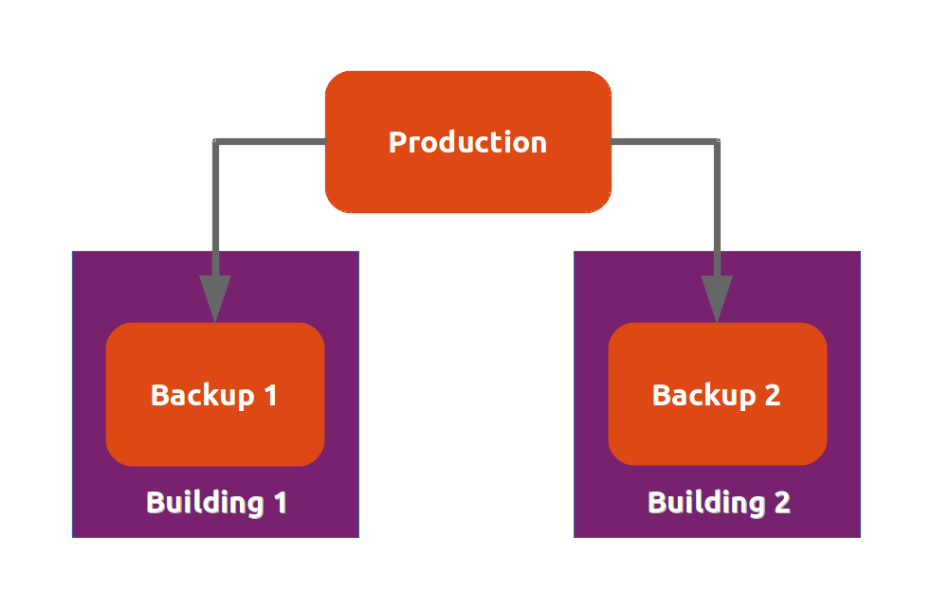
Essential System Administration Infrastructure for Disaster Recovery

Slide 12
How to implement a disaster recovery system (1)
Architecture
Each backup server is in a different building.
Each building is separately located on campus.
Each backup server uses Ubuntu LTS server software.
Each backup server has BackupPC installed.
BackupPC is setup to use the "rsyncd" method for pulling in the backups from the production server.
http://wiki.lib.sun.ac.za/index.php/SUNScholar/Disaster_Recovery/Backups

Slide 13
How to implement a disaster recovery system (2)
Client Configuration
Step 1. Setup local daily backup
Step 2. Enable local sync to remote server
http://wiki.lib.sun.ac.za/index.php/SUNScholar/Disaster_Recovery/Backups/Client_Setup

Slide 14
How to implement a disaster recovery system (3)
Client Configuration
The first step is to create a backup script on each server to be backed up.
The link below has details of the script and how to create it.
http://wiki.lib.sun.ac.za/index.php/SUNScholar/Disaster_Recovery/Backups/Local

Slide 15
How to implement a disaster recovery system (4)
Client Configuration
The second step is to create an “rsync” config file on each server to be backed up.
The link below has details of the config file and how to create it.
http://wiki.lib.sun.ac.za/index.php/SUNScholar/Disaster_Recovery/Backups/Client_Setup/Server_Sync

Slide 16
How to implement a disaster recovery system (5)
Server Configuration
On each backup server we install “backuppc”.
We define firewall rules per server to be backed up.
Then we add the servers to be backed up to the “backuppc” server configuration.
http://wiki.lib.sun.ac.za/index.php/SUNScholar/Disaster_Recovery/Backups/Server_Setup

Slide 17
Conclusion
Technical system administration is an essential task for any organisation that is serious about building capacity to host their own open scholarly communication systems.
See: http://wiki.lib.sun.ac.za/index.php/SUNScholar/Capacity_Building

